Slide 1

DEEP NEURAL NETWORKS FOR AN INTELLIGENT WASTE SORTING SYSTEM
SAMMY OYARO NJOROGE – ENE221-0116/2017
BRIAN OUKO NYANAMBA – ENE221-0306/2017
Supervisor: DR. LAWRENCE C. NGUGI

Slide 2
Introduction
Waste sorting is a process in waste management that involves separation of different elements of waste based on their eventual methods of disposal, to enable more efficient handling.
Though sorting is only an intermediary step in the process of waste management, it has been found to reduce the amount of household waste that ends up in landfills by about two thirds, when done in decentralized locations.

Slide 3
Problem statement
Different waste sorting and classification approaches have limiting shortcomings that affect the implementation and eventual performance of the final prototypes.
Waste sorting systems using sensors often inaccurate as some items can hardly been detected using conventional sensing techniques.
The majority of current waste classification systems are resource-intensive in terms of computational power
Existing automated systems are implemented using expensive equipment resulting to high realization cost.

Slide 4
OBJECTIVES
To develop an intelligent waste sorting system based on convolution neural networks to achieve waste sorting.
To collect and organize a large image dataset of four categories of waste items, i.e., glass, plastic, cans, metal and paper.
To train and compare the performance of different convolutional neural network architectures in waste classification.
To implement the best performing CNN model for waste classification on an embedded computer.
To construct a garbage sorting machine with distinct compartments for the four categories of waste.
To achieve an accurate and low computational cost model for waste sorting.
To interface sensors with the embedded computer for fill-level monitoring.
To test the waste sorting system for detection of waste items in the desired category.

Slide 5
Literature REVIEW
Broadly, previously proposed systems can be grouped as IoT-based, machine learning shallow classifiers and deep learning algorithms.
The first uses connection of sensors, actuators and communication technologies eliminates human intervention. Sensor-based systems offer a decent approach in terms of automation but can only achieve semi-intelligence at best and are therefore limited in the accuracy.
Shallow classifiers use machine learning algorithms to generate a generalized predictive models.

Slide 6
CONT.
The common shallow classifier algorithms that have been applied in image classification for waste management are Support Vector Machine (SVM) and Random Forest (RF).
Shallow classifiers, however, require the designer choose image features to work with hence not ideal in a practical context.
The image classification use case of deep learning (convolutional neural networks) has also been explored in this context.
This approach guarantees a high accuracy for waste classification if is executed well and in a supporting environment.

Slide 7
METHODOLOGY
A CNN is made of a sequence of several layers interspersed with activation functions.
The CNN architecture is made of the convolutional layer, a pooling layer and a fully connected layer.
Each consecutive layer performs a differentiable function to transform one volume of activations into another.
The prototype build consists of two functional elements - waste detection & classification and real-time sorting.

Slide 8
PROTOTYPE DEVELOPMENT
DATA PREPARATION | MODEL TRAINING AND VALIDATION | FINAL DEPLOYMENT | SYSTEM TESTING
Data (Image) collection Dataset organization | CNN model selections Hyperparameter selection Training with dataset images | Deploying the model in on the cloud platform. | Testing the model when implemented in a real-life prototype

Slide 9
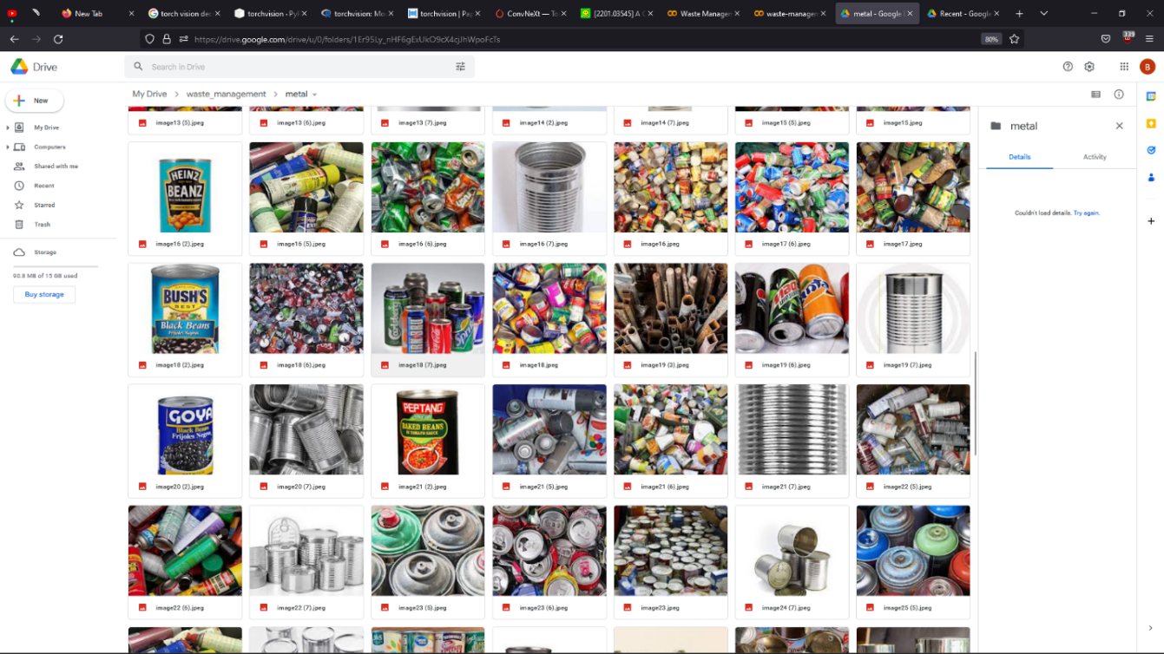
Implementation
Objective: To collect and organize a large image dataset of four categories of garbage; glass, plastic, cans and metal, and paper waste.

Slide 10

Implementation
Objective: To train and compare the performance of different convolutional neural network models in waste classification.

Slide 11

implementation
Objective: To implement the best performing CNN model for waste classification on an embedded computer.

Slide 12


Slide 13
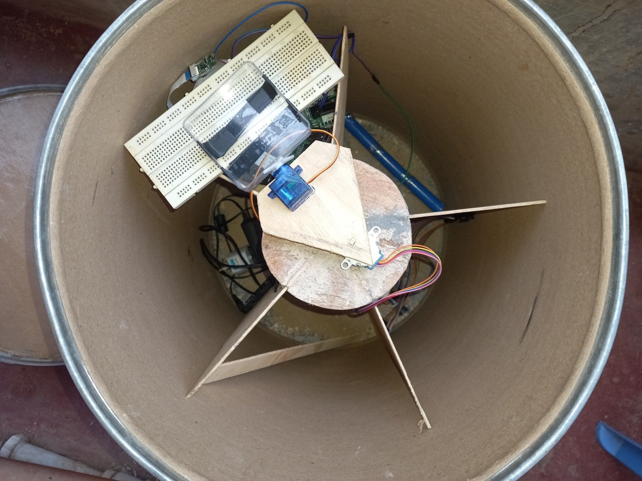
THE BIN’S BUILD

Slide 14
The Bin’s build
The camera switches to take a picture after an interval and sends the data to the Raspberry Pi.
The microcontroller processes the captured image by running an inference against the optimal CNN model.
The classification result determines the action and motion of the actuator that automate the waste sorting operation. The motor (actuator) is triggered by the results to initiate motion that pushes the waste material into the right compartment.
The interval of taking images is chosen to allow for sufficient time for the disposed waste item to be still. The camera sensors are automatically adjusted to the lighting to help produce a clear picture.

Slide 15
RECOMMENDATIONS
We recommend that in the future, this project could employ a camera with motion detection to eliminate the problematic issue of getting the object at the ‘ideal’ position before a steady image is captured.
We also recommend that more power computing hardware be employed where the classification model is deployed on the local machine.
This alleviates the recurring cost that is otherwise incurred when paying for computing space on a cloud environment.

Slide 16
RECOMMENDATIONS
Better computing environments will also ease on training models natively with even larger datasets and more precise results.
Moreover, a more effective method of determining fill-level measurements, rather than installing individual infrared sensors across five compartments, which is ineffective and contrary to the sustainability goal of this project.

